Slide 1


Introduction to TensorFlow
Introduction to TensorFlow

Slide 2

Agenda
What is TensorFlow?
Why would you use it?
How does it work? + Demo
CloudML (alpha) discussion
Introduction to TensorFlow
2

Slide 3
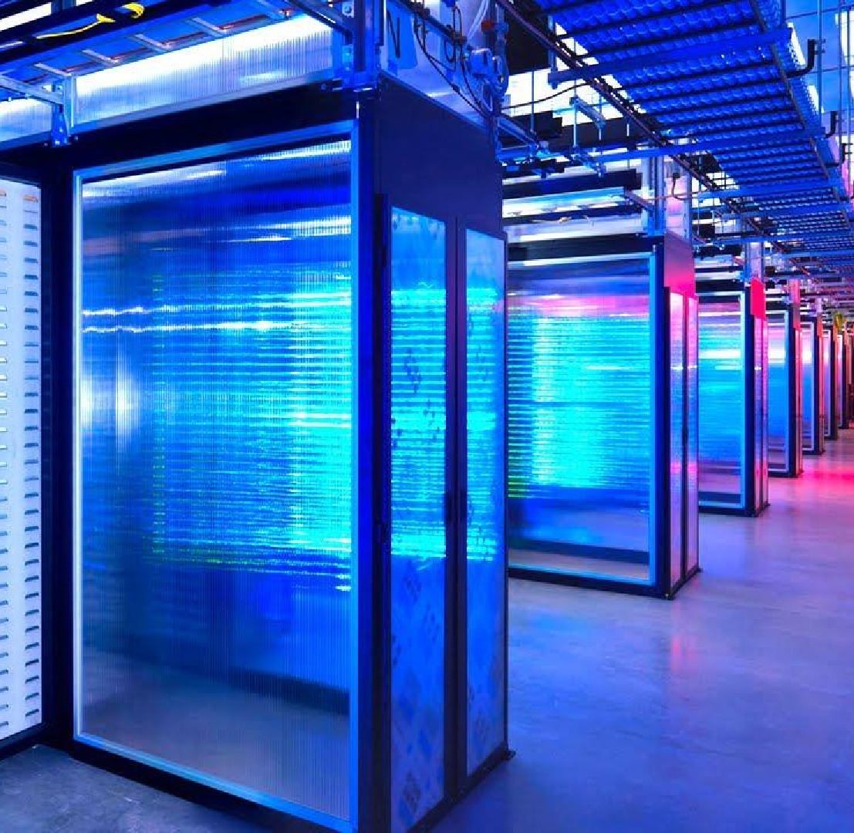
TensorFlow
Google TensorFlow
Originally developed by the Google Brain Team within Google's Machine Intelligence research organization
TensorFlow provides primitives for defining functions on tensors and automatically computing their derivatives.
An open source software library for numerical computation using data flow graphs
PLACE IMAGE HERE
4

Slide 4
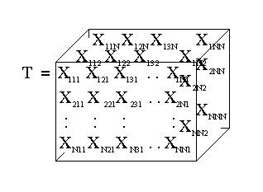
Tensor?
Simply put: Tensors can be viewed as a multidimensional array of numbers. This means that:
A scalar is a tensor,
A vector is a tensor,
A matrix is a tensor
...
4

Slide 5
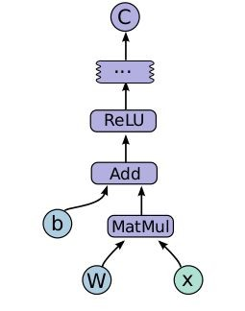
Data Flow Graph?
Computations are represented as graphs:
Nodes are the operations (ops)
Edges are the Tensors
(multidimensional arrays)
Typical program consists of 2 phases:
construction phase: assembling a graph (model)
execution phase:
pushing data through the graph
5

Slide 6
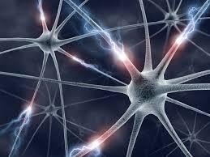
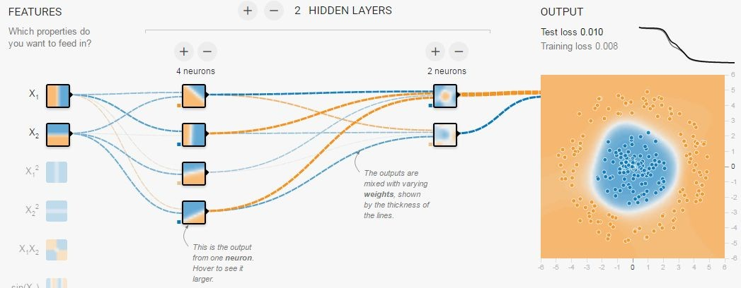
Neural Networks? Deep Learning?
Neural Networks are represented by the lower figure, not the top one....
Link:
Tinker with a Neural Network in Your Browser
6

Slide 7
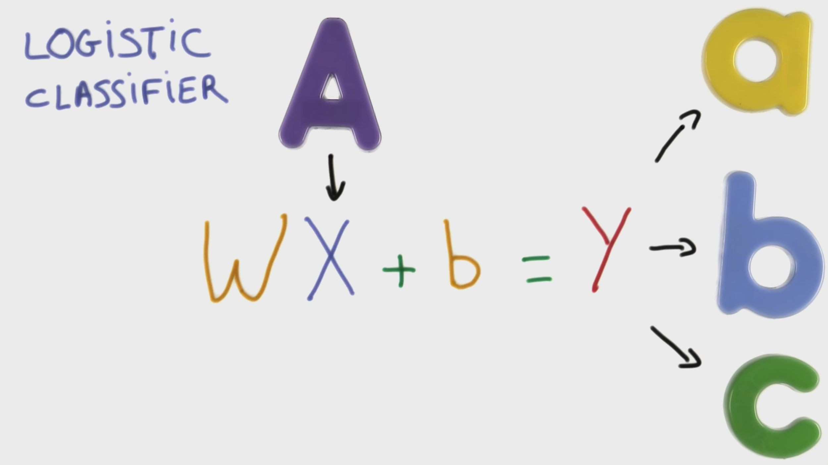
Presentation title (Go to View > Master to edit) 8
Source: https://www.udacity.com/course/deep-learning--ud730

Slide 8
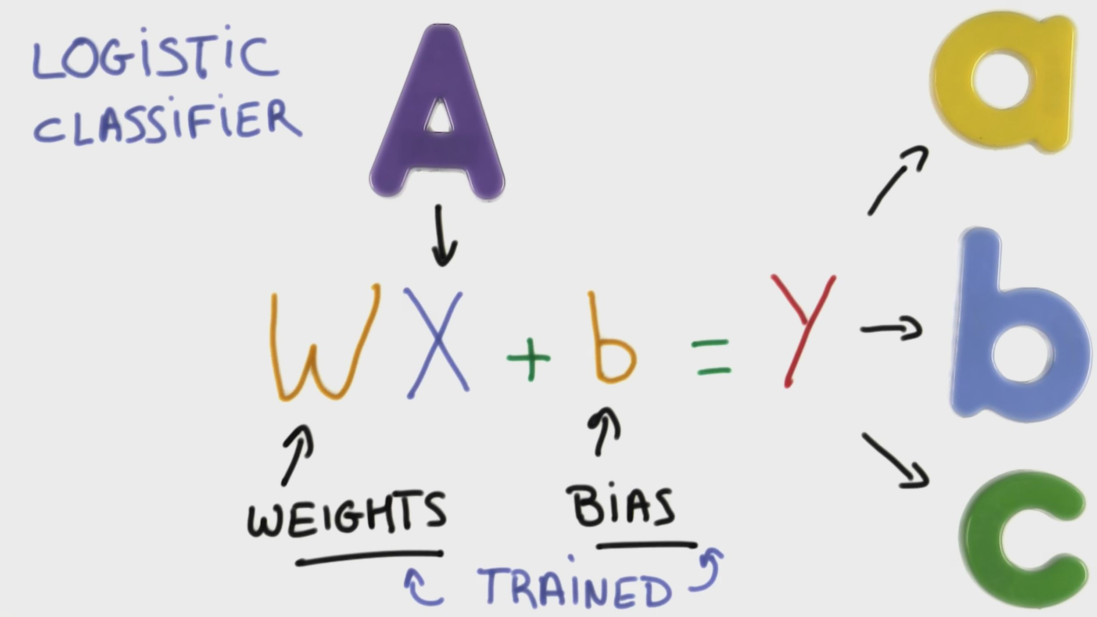
Presentation title (Go to View > Master to edit) 9
Source: https://www.udacity.com/course/deep-learning--ud730

Slide 9
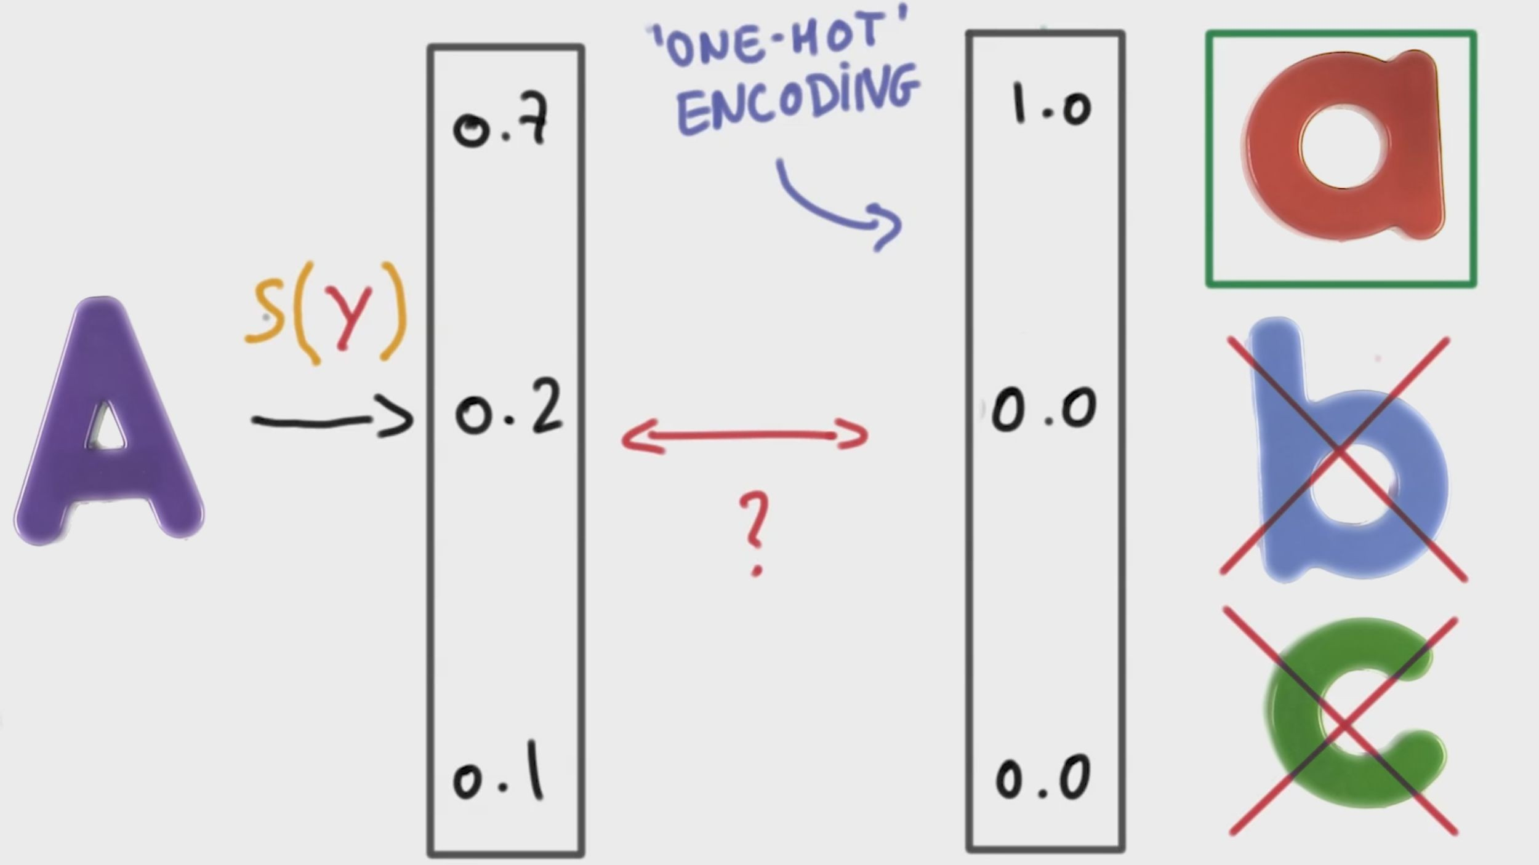
Presentation title (Go to View > Master to edit) 10
Source: https://www.udacity.com/course/deep-learning--ud730

Slide 10
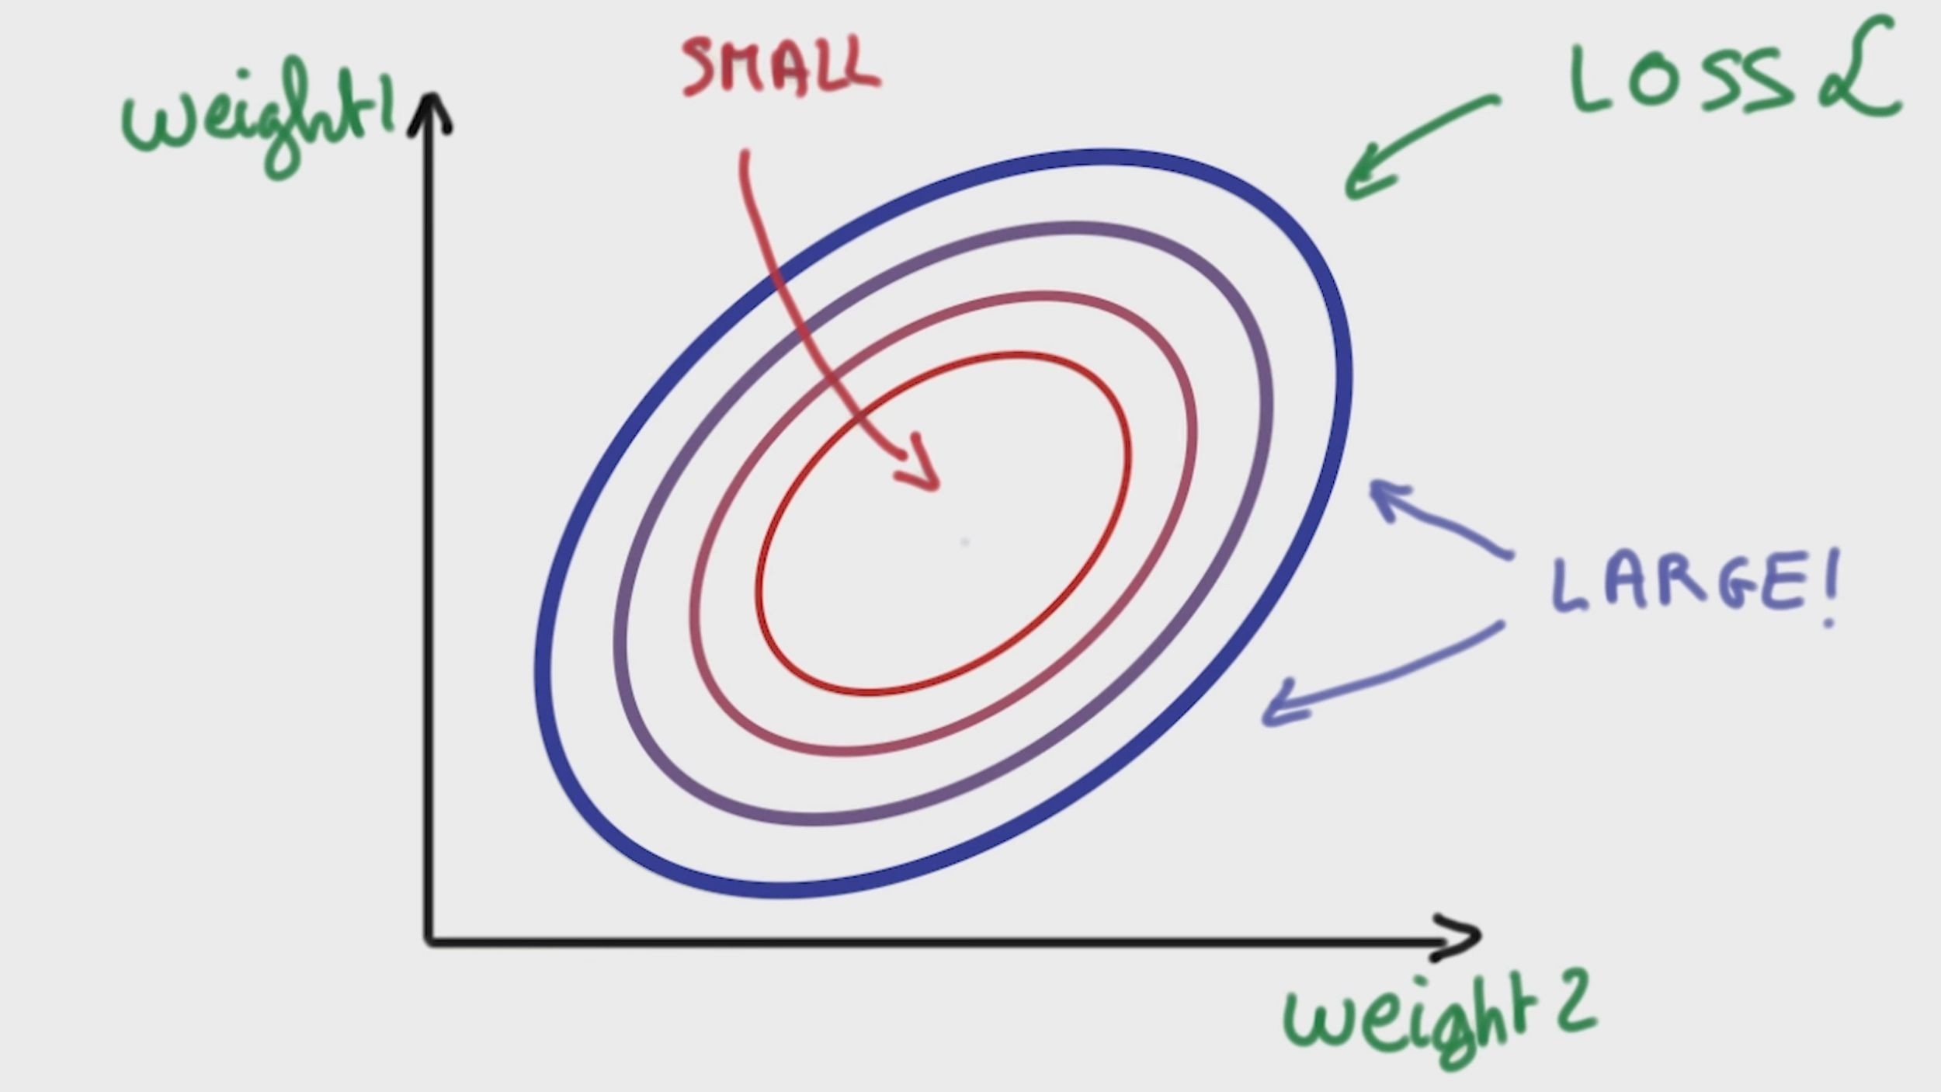
Presentation title (Go to View > Master to edit) 11
Source: https://www.udacity.com/course/deep-learning--ud730

Slide 11
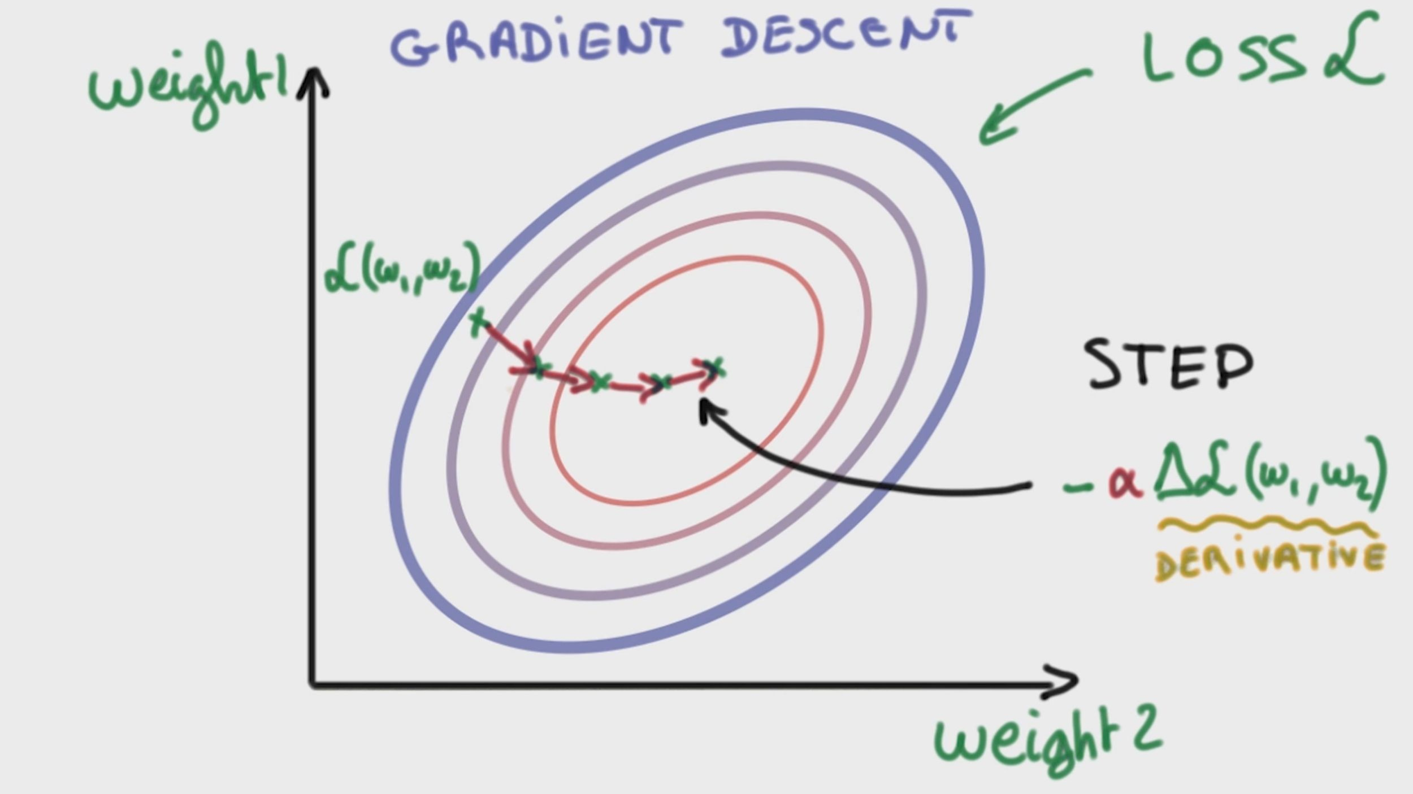
Presentation title (Go to View > Master to edit) 12
Source: https://www.udacity.com/course/deep-learning--ud730

Slide 12
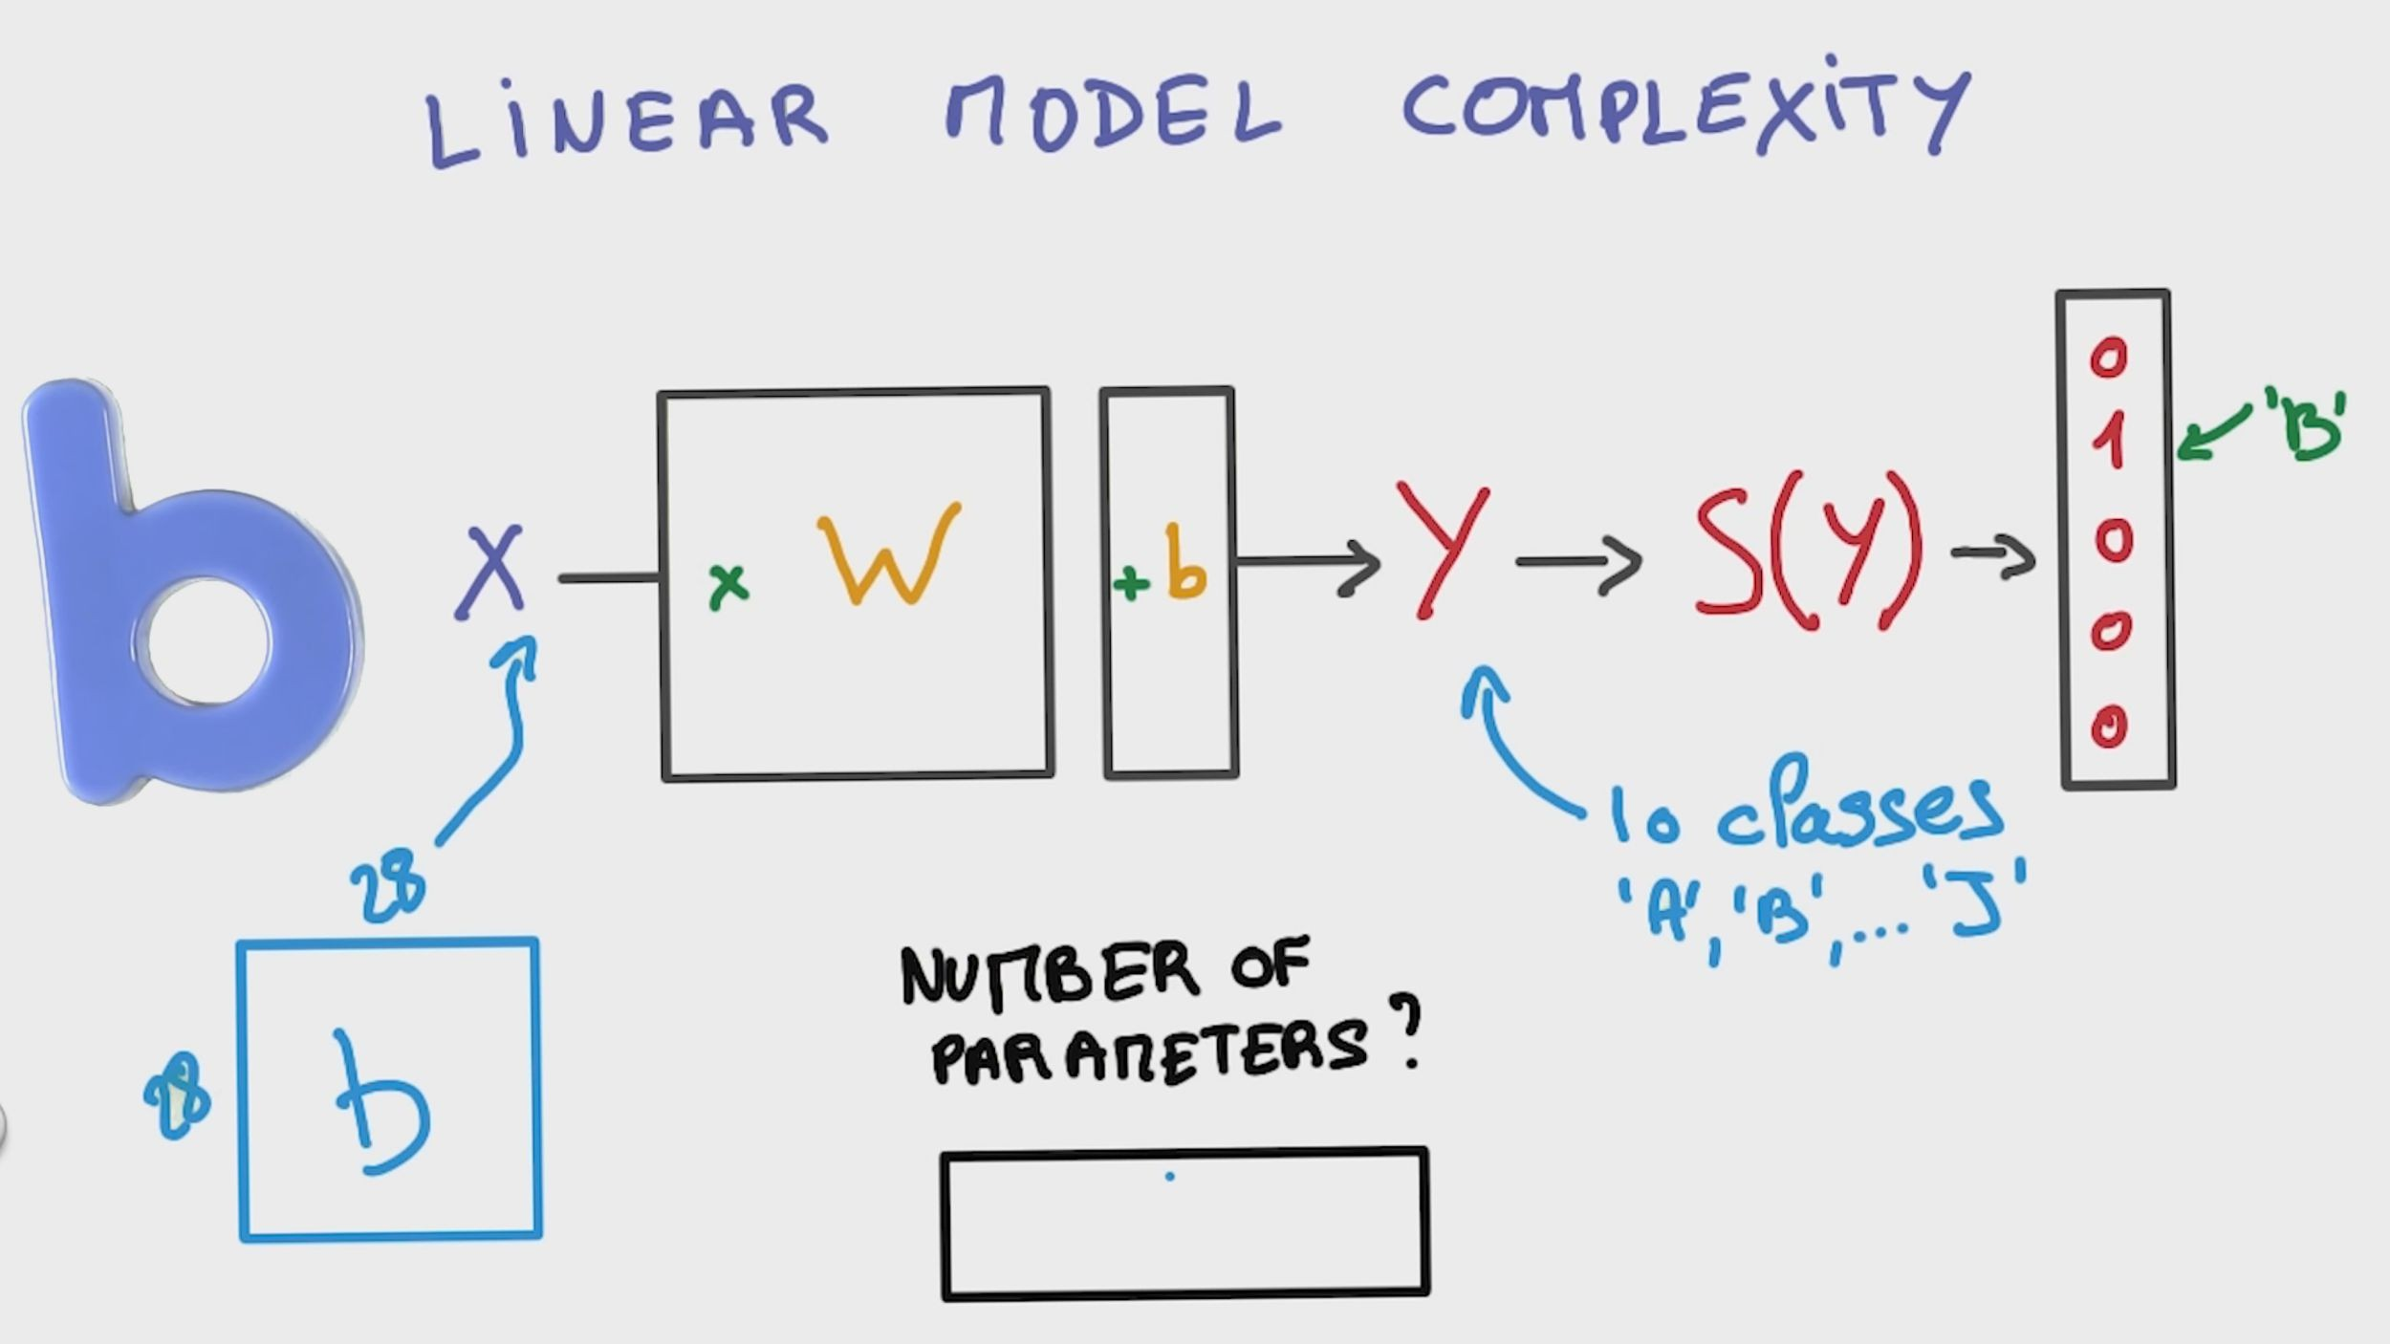
Presentation title (Go to View > Master to edit) 13
Source: https://www.udacity.com/course/deep-learning--ud730

Slide 13
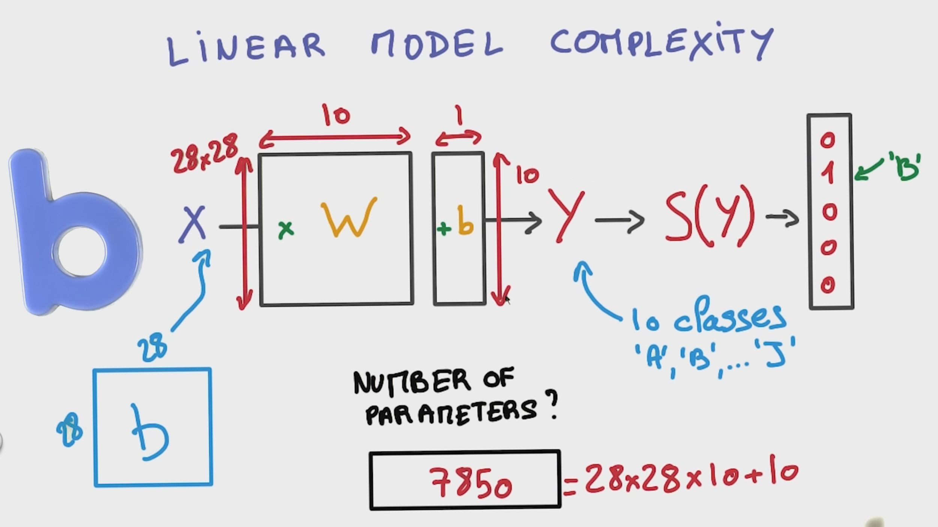
Presentation title (Go to View > Master to edit) 14
Source: https://www.udacity.com/course/deep-learning--ud730

Slide 14
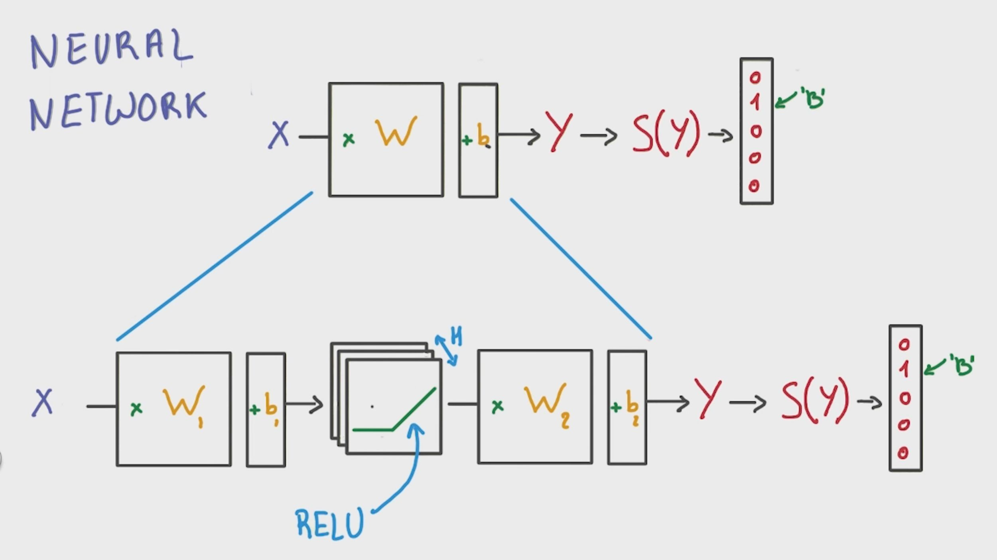
Presentation title (Go to View > Master to edit) 15
Source: https://www.udacity.com/course/deep-learning--ud730

Slide 15
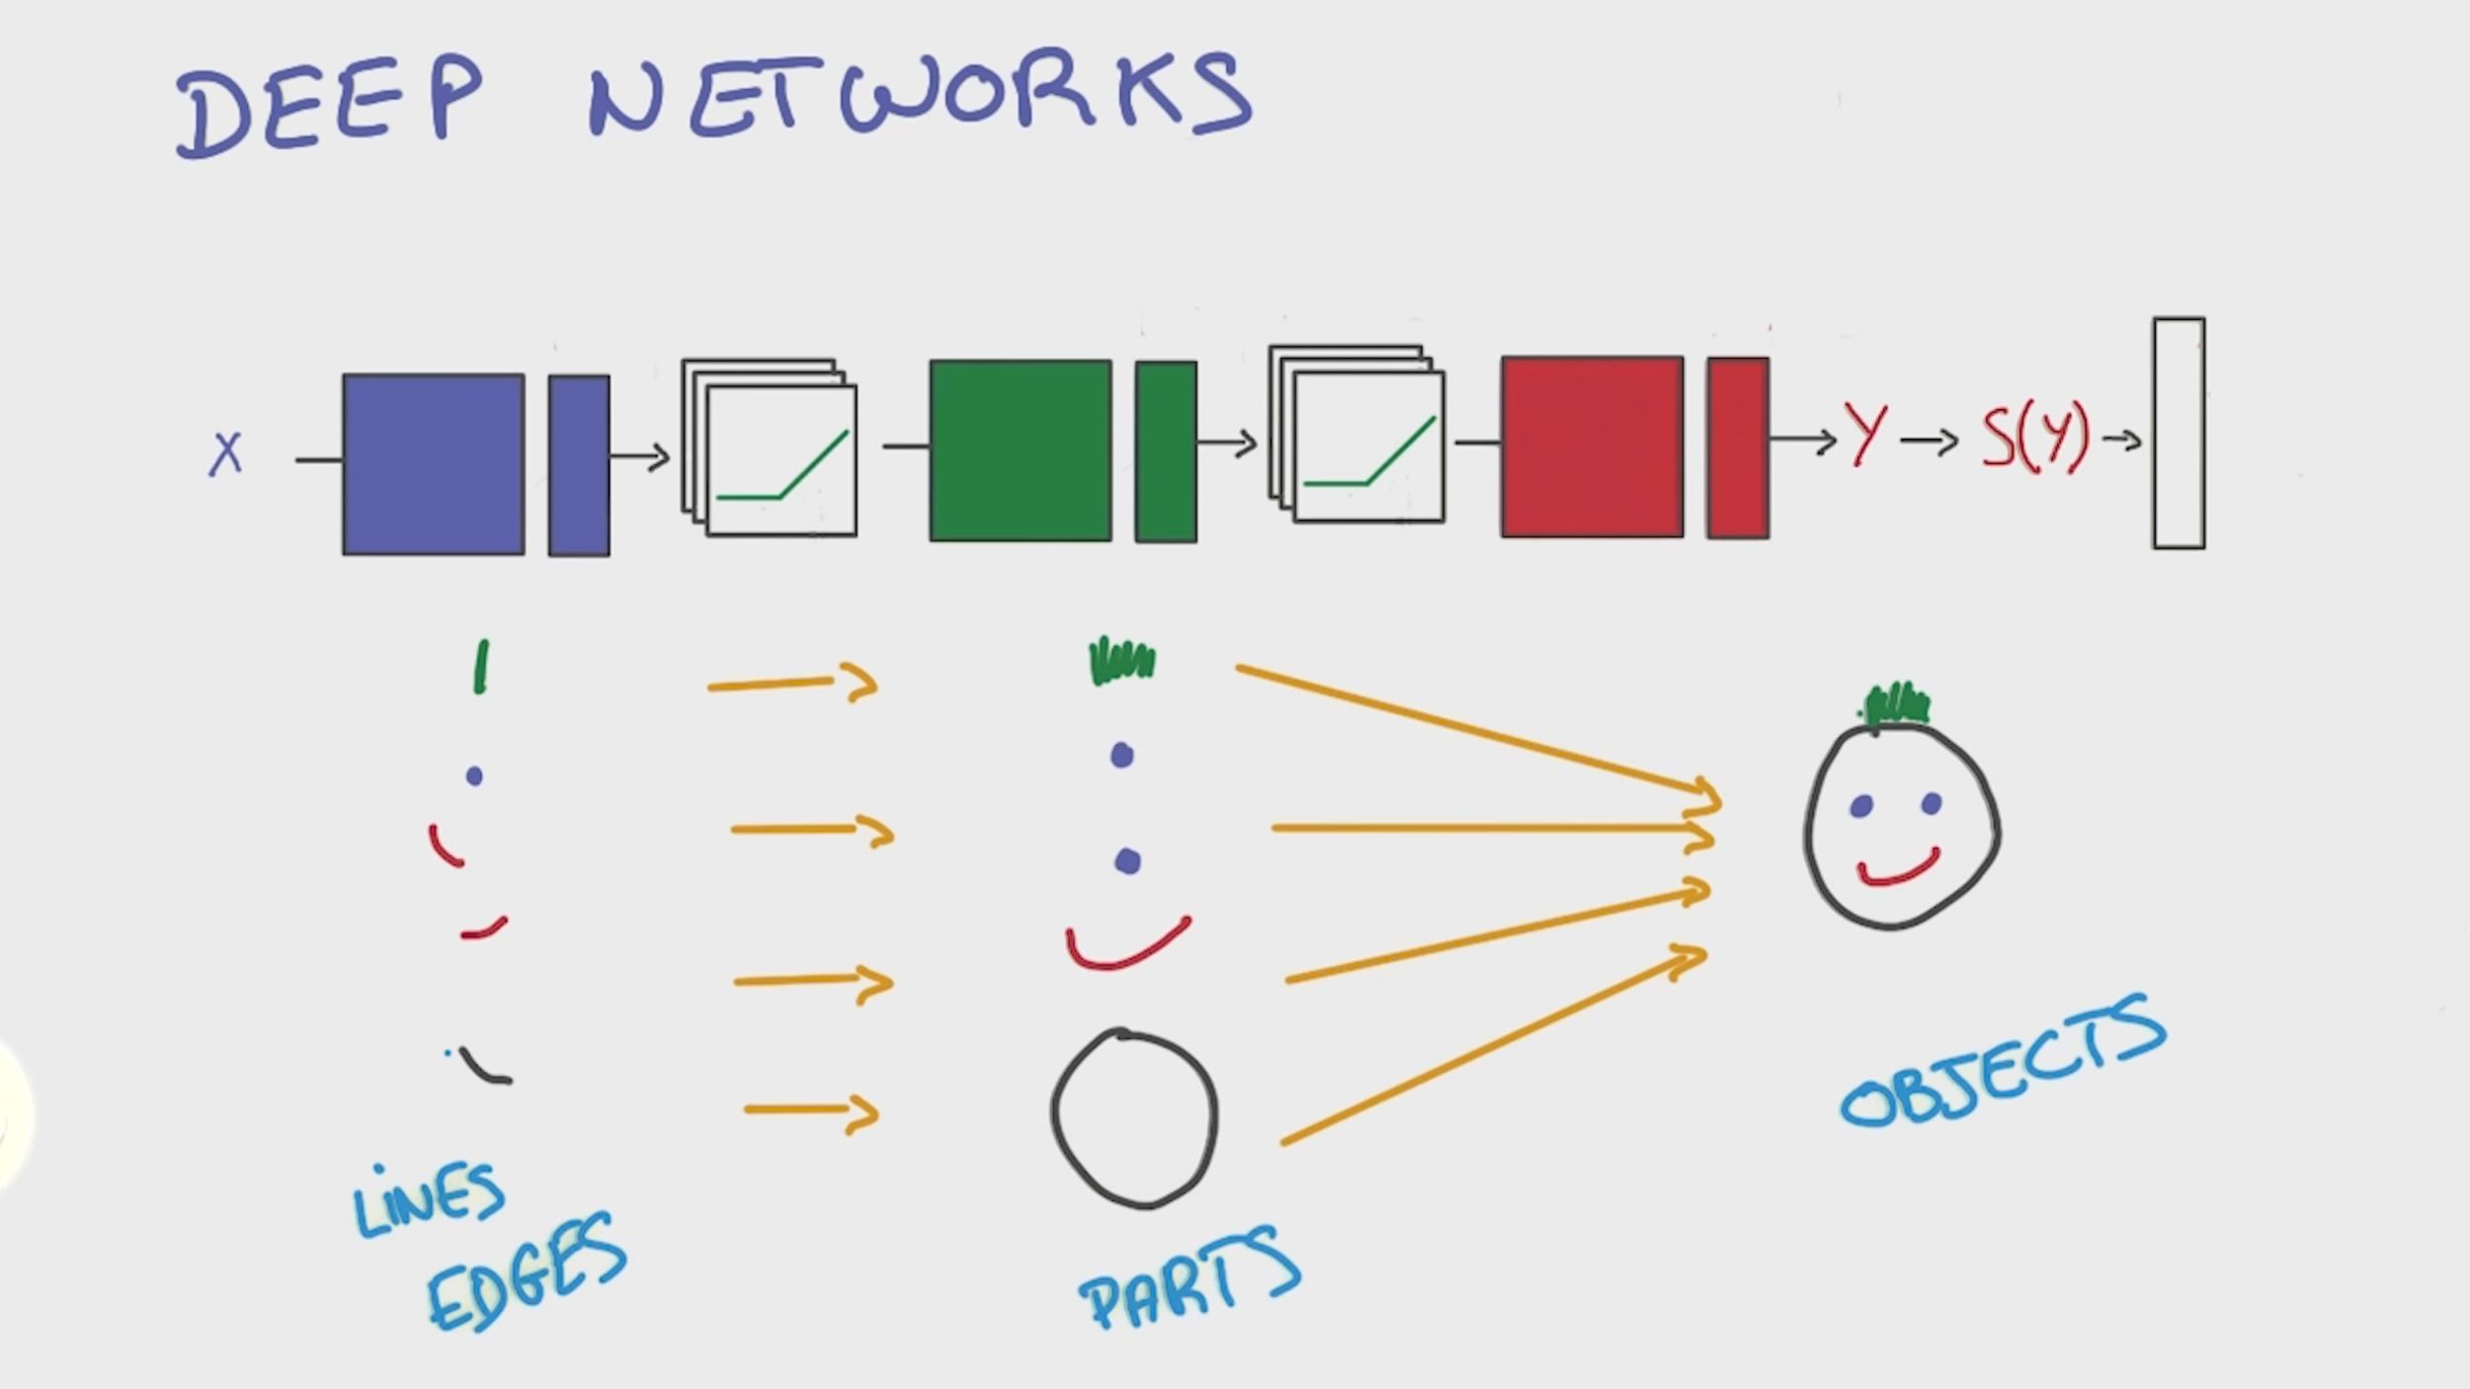
Presentation title (Go to View > Master to edit) 16
Source: https://www.udacity.com/course/deep-learning--ud730

Slide 16
Agenda
What is TensorFlow?
Why would you use it?
How does it work? + Demo
CloudML (alpha) discussion
Introduction to TensorFlow
17

Slide 17
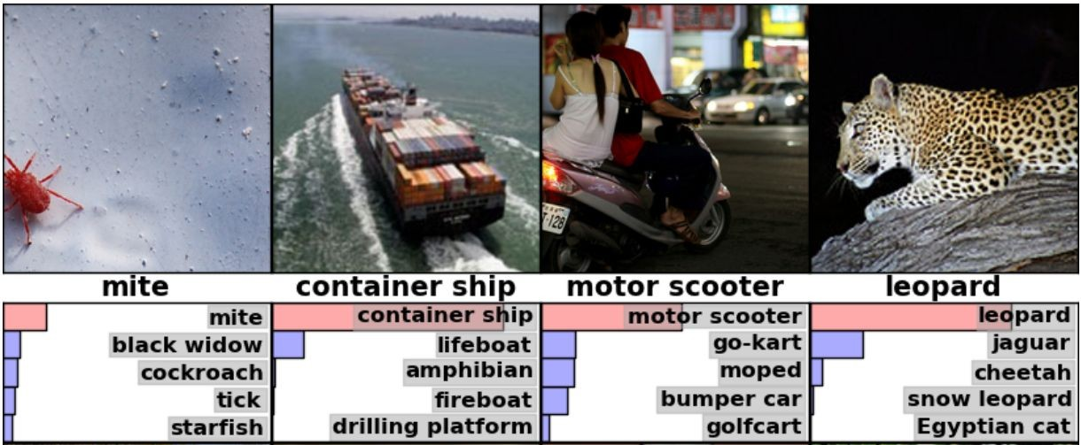
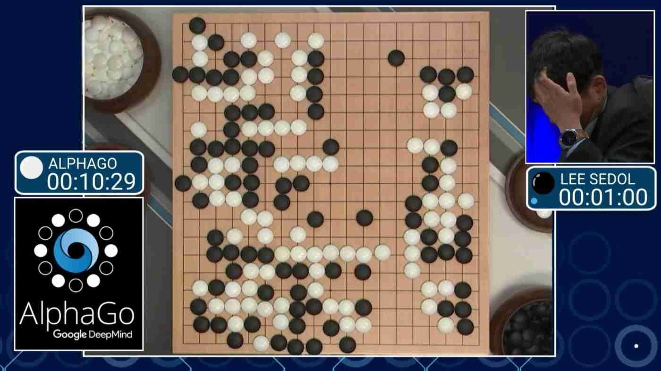
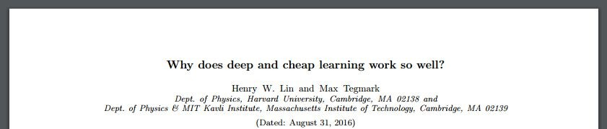
Why would you use NN / Deep Learning?
Neural Networks (NNs) are universal function approximators that work very well with huge datasets
NNs / deep networks do unsupervised feature learning
Track record, being SotA in:
image classification,
language processing,
speech recognition,
...
Intr
oduction to TensorFlow
18

Slide 18
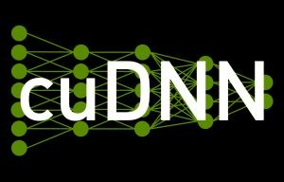

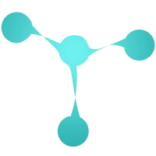


Why TensorFlow?
There are a lot of alternatives:
Torch
Caffe
Theano (Keras, Lasagne)
CuDNN
Mxnet
DSSTNE
DL4J
DIANNE
Etc.
19

Slide 19
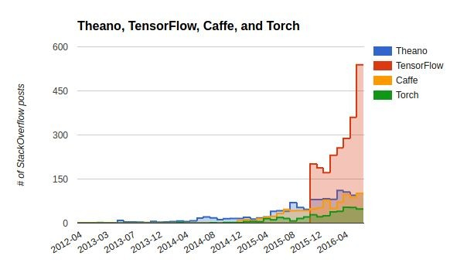
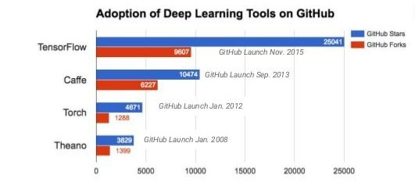
TensorFlow has the largest community
Introduction to TensorFlow
20

Slide 20
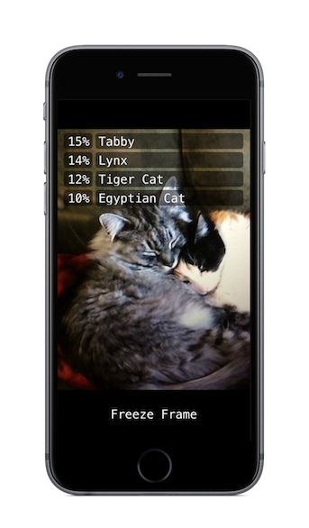
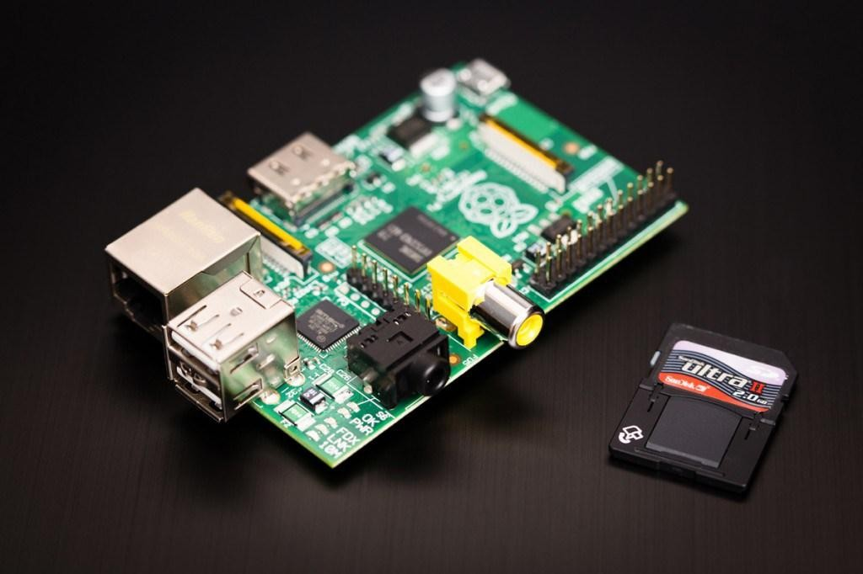
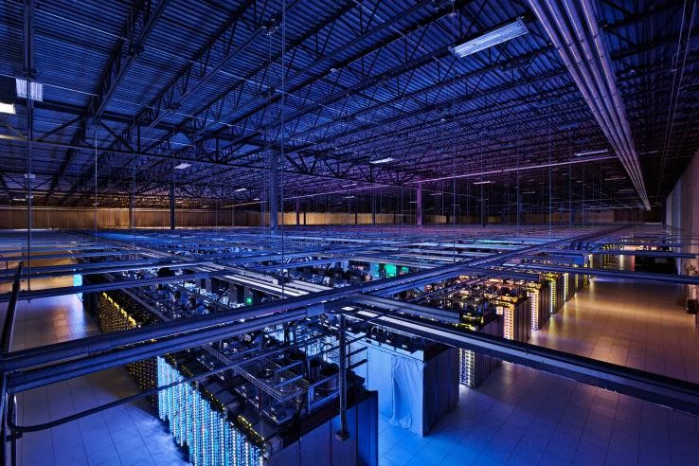
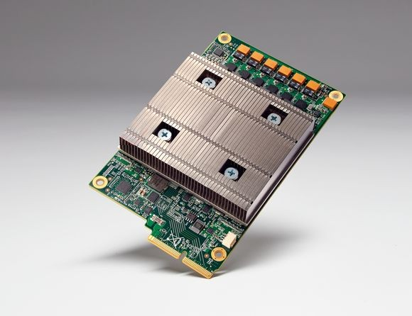
TensorFlow is very portable/scalable
Runs on CPUs, GPUs, TPUs over one or more machines, but also on phones(android+iOS) and raspberry pi’s...
Introduction to TensorFlow

Slide 21
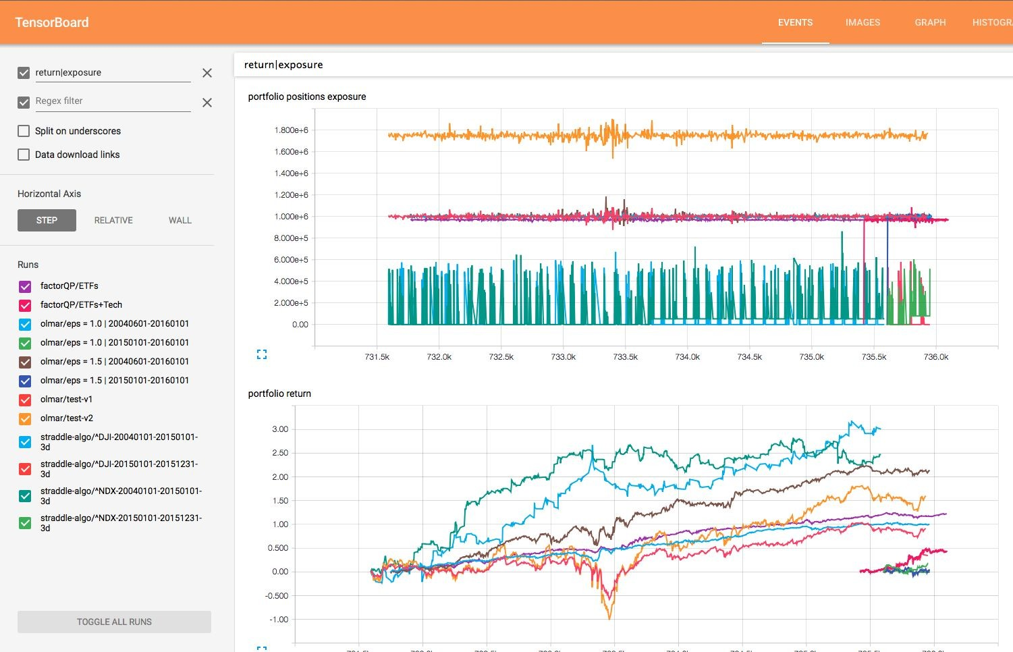
TensorFlow is more than an R&D project
Specific functionalities for deployment (TF Serving / CloudML)
Easier/more documentation (for more general public)
Included visualization tool (Tensorboard)
Simplified interfaces like SKFlow
Introduction to TensorFlow

Slide 22
Agenda
What is TensorFlow?
Why would you use it?
How does it work? + Demo
CloudML (alpha) discussion
Introduction to TensorFlow

Slide 23
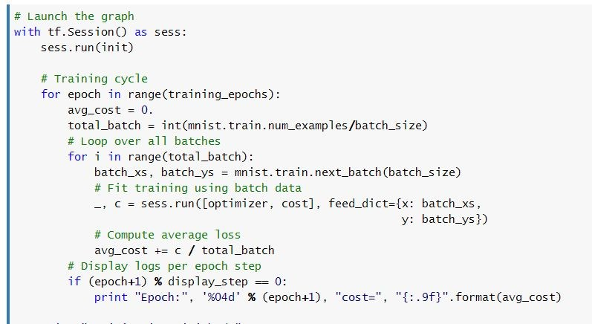
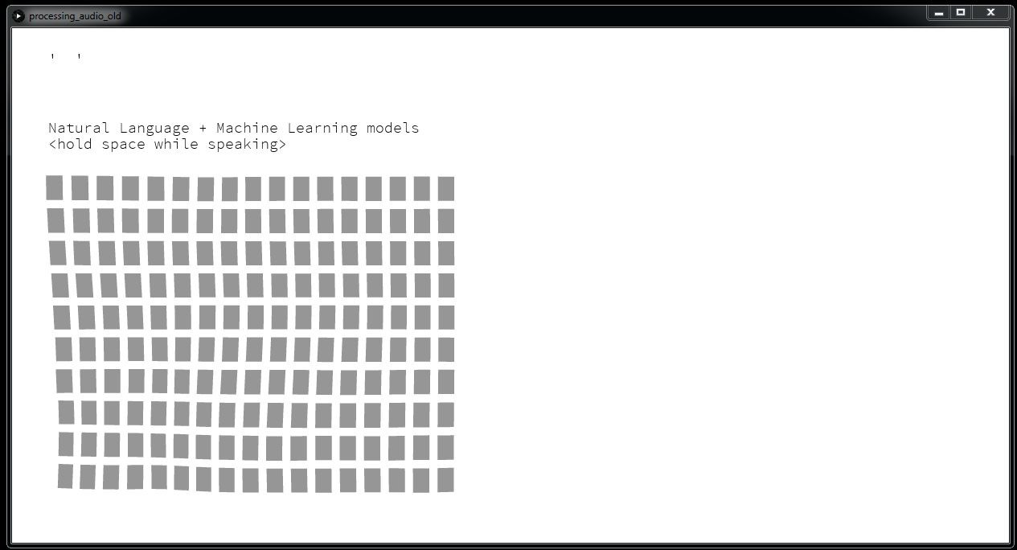
How does it work?
Number Recognition \w TF explained (in notebook)
Speech classification (demo)
Tensorboard notebook: here
Great starting point: https://github.com/tensorflow/models
Introduction to TensorFlow

Slide 24
Agenda
What is TensorFlow?
Why would you use it?
How does it work? + Demo
TF on Cloud – Azure
Introduction to TensorFlow

Slide 25
Further reading
Curated list of TF resources: https://github.com/jtoy/awesome-tensorflow
Models implemented in TF: https://github.com/tensorflow/models
Slides “TF tricks of the trade”: https://drive.google.com/open?id=x_...
Slides “TF and Deep Learning without a PhD”: https://docs.google.com/presentation/d/...
Blogpost “DL with spark and TF”: https://databricks.com/blog/...
The official documentation: https://www.tensorflow.org/versions/r0.10/...
Introduction to TensorFlow

Slide 26
Thank you
Introduction to TensorFlow

